Slide 1

How to improve the design of Reproductive Health (RH) interventions to meet the health access needs of adolescents (15-19 years) living in urban poor settings of Kampala, Uganda
Doreen Tuhebwe, Susan Babirye, Steven Ssendagire, Freddie Ssengooba
Makerere University School of Public Health, Uganda
The Be-cause Health Conference on Urban, 16th October 2019

Slide 2
Introduction
Access to and utilization of health services has remained a challenge for the urban poor worldwide.
The high rates at which urban informal settlements/slums are developing in Uganda make health for the urban poor an urgent priority.
In the 2016 Uganda Demographic Health Survey, 16.8% of adolescents aged 15-19 had begun child bearing in Uganda’s capital Kampala
The situation is worse in urban poor set ups of Kisenyi (the largest slum in Kampala)
This indicates that reproductive health (RH) interventions/services such as adolescent friendly corners, have not yielded outcomes
There is need to ensure that the design of current and future RH interventions meet the access needs of the targeted adolescents
Notes:
Low access to services hinders achievement of Sustainable Development Goal (SDG) 3 that seeks to ensure health and well-being for all
As a result of increased population growth rate, many informal settlements or slums clustered with poverty and poor living conditions have mushroomed in many cities in LMICs like Uganda.
Slums have compounded vulnerabilities of low education, poverty and lack of access to appropriate reproductive health (RH) interventions.
Adolescent friendly corners, have not yielded much in terms of health outcomes as evidenced by the persistent poor health indicators of the urban poor
We are conducting a study to explore how to improve the design of Reproductive Health (RH) interventions to meet the health access needs of the teenagers living in urban poor settings of Kampala.

Slide 3
Objectives
To determine the extent to which the available reproductive health interventions meet the health access needs of the adolescents 15-19 living in the urban poor settings of Kisenyi, Kampala, Uganda

Slide 4
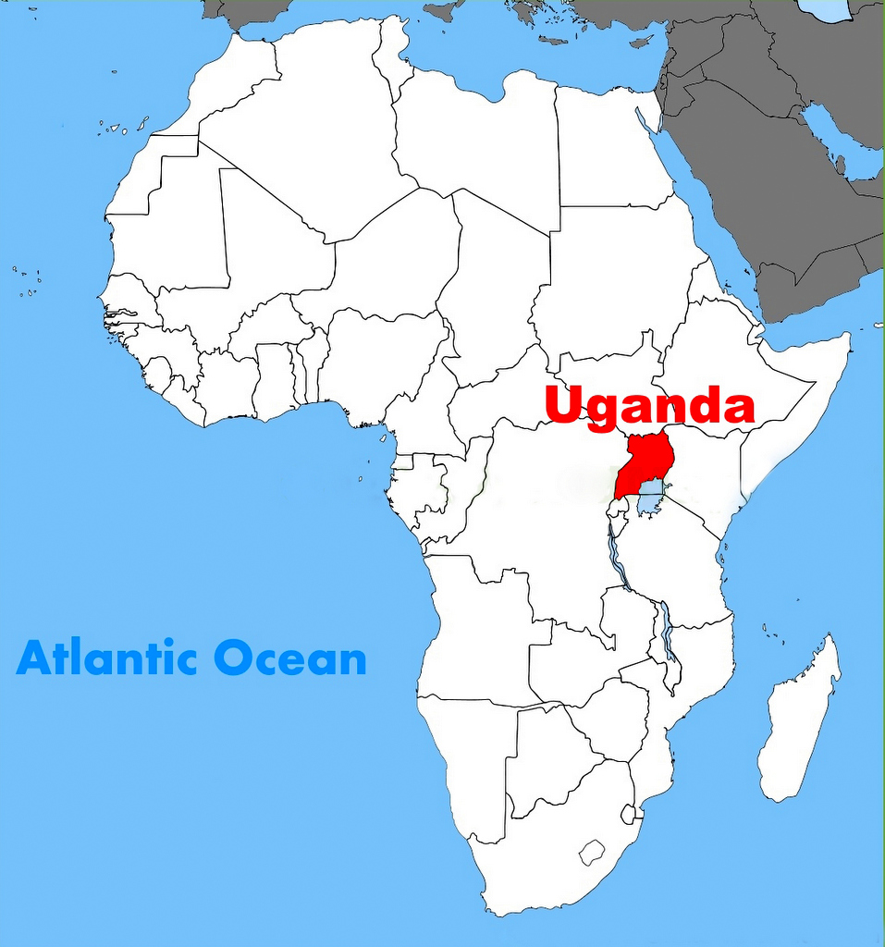
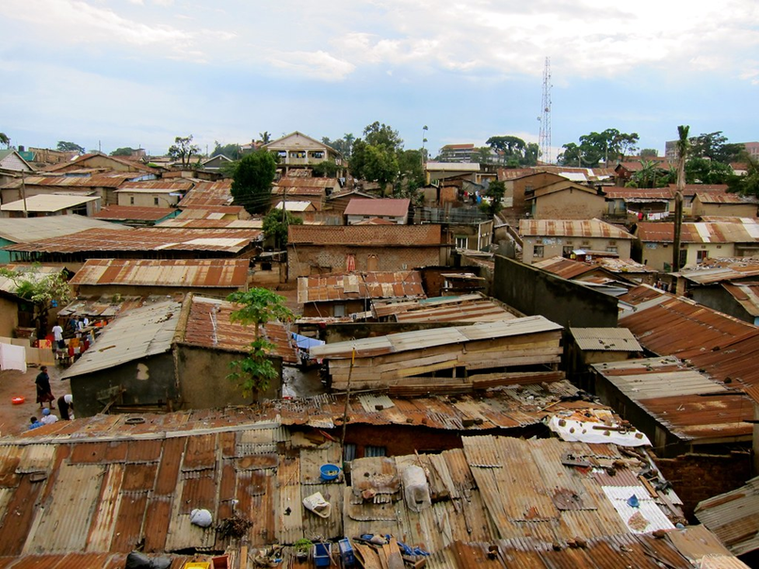
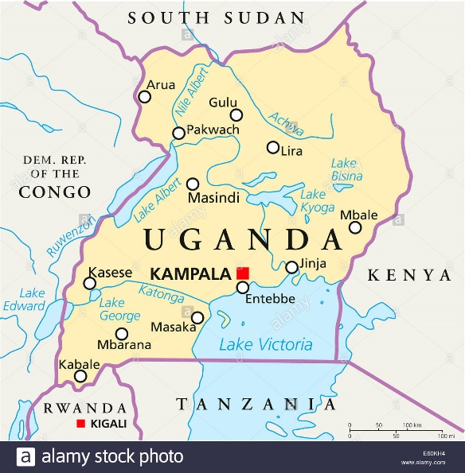
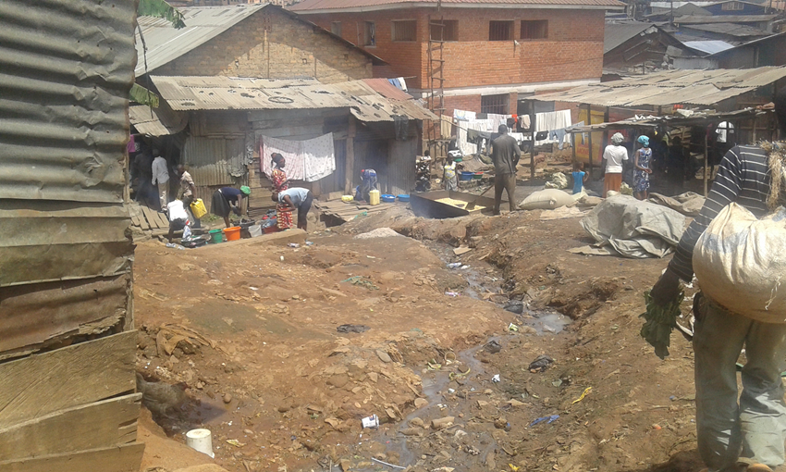
The Kisenyi Slum in Kampala, Uganda
https://dispatch.ug/2018/09/13/uganda-among-top-10-african-countries-relatively-good-policies-report/uganda-location-on-the-africa-map/
https://www.flickr.com/photos/sdinet/6058473267

Slide 5
Methods
.
Focus group discussions (FGDs) held with adolescents 15-19 years in Kisenyi
  Probed their reproductive Health (RH) access needs.
  Probed the current RH interventions/services for the adolescents
Key Informant Interviews (KIIs) with urban authorities and service provider held
  Described the design and implementation features of the current RH interventions/services for the adolescents
We evaluated the design and implementation features of the available interventions against the adolescent access needs
    Identified extent of fit of the intervention design with the identified adolescent RH access needs.
Notes:
Results can inform a structured movement from the identification of needs to intervention design and implementation that fit the RH access needs of adolescents living in urban poor settings.

Slide 6
Adolescent reproductive health (RH) needs | Current intervention design parameter(s) | Extent of fit of intervention design parameter with the identified adolescent RH access needs *Poor fit **Moderate fit ***Good fit ****Excellent fit
Needs: Livelihood, Sanitation, health information, sexual health services (STI management); parenting, substance abuse management | Scope: Mainly target sexual health and health information | **
Key needs: social (livelihood, sanitation, parenting); Sexual RH (STI management) | Focus: Sexual RH needs like family planning products, HIV testing and treatment Less focus on social needs | **
Desired: Interventions that target specific subpopulations (10-14, 15-19, married vs unmarried, out of school vs in-school) | Target group: Generic_10-24 year olds | **
Appropriateness: Interventions appropriate for an “urban poor adolescent” | Appropriateness: Generic_ target general population | *
Desired intervention delivery model: Regular holistic community-based | Delivery model: Mainly facility based with few and inconsistent community outreaches | *
Aspirations: Empowered and self-reliant | Intended outcomes: reduced STI/HIV incidence, reduced unwanted pregnancies, behavior change | **

Slide 7
Conclusion
While interventions mainly focus on sexual reproductive health, the key adolescent RH needs are social especially livelihood
Adolescents in urban poor settings require complex programing to holistically address their reproductive health challenges

Slide 8
Thank you
Questions?

